Slide 1
Database - Introduction -

Slide 2
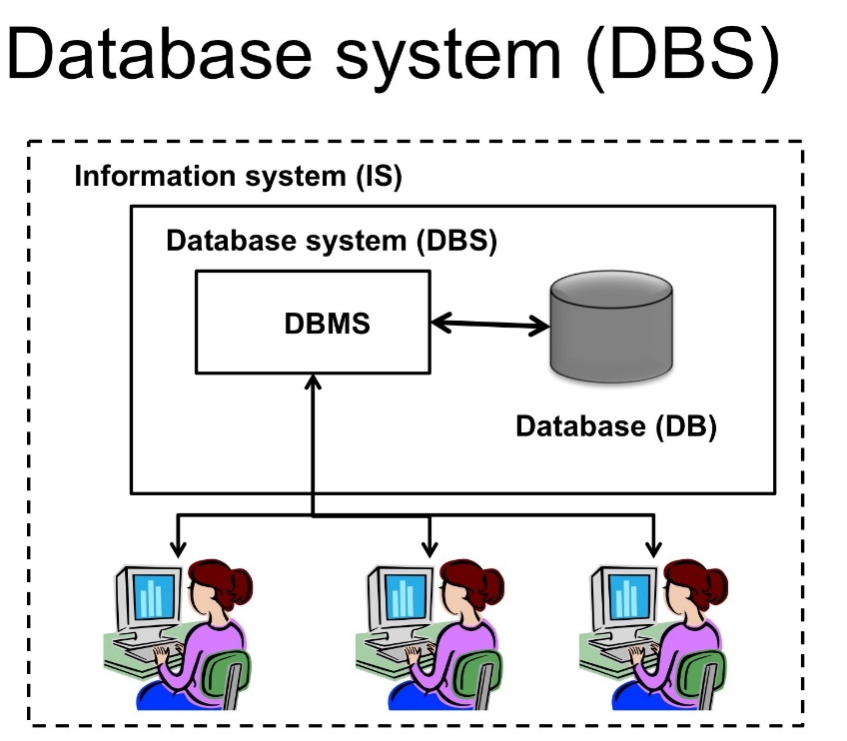
What is a Database
Database is a collection of related data and data is a collection of facts and figures that can be processed to produce information.
Mostly data represents recordable facts. Data aids in producing information, which is based on facts. For example, if we have data about marks obtained by all students, we can then conclude about toppers and average marks.
A database management system(DBMS) stores data in such a way that it becomes easier to retrieve, manipulate, and produce information.

Slide 3
Database Characteristics
Traditionally, data was organized in file formats. DBMS was a new concept then, and all the research was done to make it overcome the deficiencies in traditional style of data management.
A modern DBMS has the following characteristics:
Real-world entity − A modern DBMS is more realistic and uses real-world entities to design its architecture. It uses the behavior and attributes too. For example, a school database may use students as an entity and their age as an attribute.
 | Relation-based tables − DBMS allows entities and relations among them to form tables. A user can understand the architecture of a database just by looking at the table names.

Slide 4

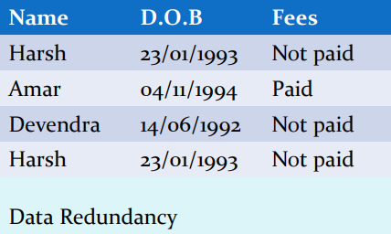
Database Characteristics
Isolation of data and application − A database system is entirely different than its data. A database is an active entity, whereas data is said to be passive, on which the database works and organizes. DBMS also stores metadata, which is data about data, to ease its own process.
 | Less redundancy − DBMS follows the rules of normalization, which splits a relation when any of its attributes is having redundancy in values. Normalization is a mathematically rich and scientific process that reduces data redundancy.

Slide 5
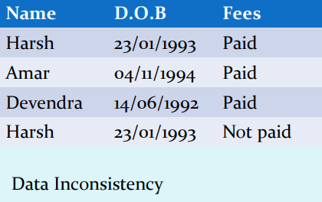
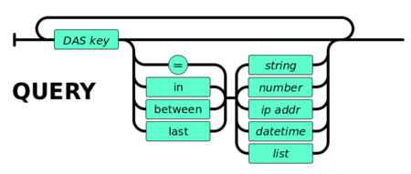
Database Characteristics
 | Consistency − Consistency is a state where every relation in a database remains consistent. There exist methods and techniques, which can detect attempt of leaving database in inconsistent state. A DBMS can provide greater consistency as compared to earlier forms of data storing applications like file-processing systems.
Query Language − DBMS is equipped with query language, which makes it more efficient to retrieve and manipulate data. A user can apply as many and as different filtering options as required to retrieve a set of data. Traditionally it was not possible where file-processing system was used.

Slide 6
Database Characteristics
 | Multiple views − DBMS offers multiple views for different users. A user who is in the Sales department will have a different view of database than a person working in the Production department. This feature enables the users to have a concentrate view of the database according to their requirements.
Security − Features like multiple views offer security to some extent where users are unable to access data of other users and departments. DBMS offers methods to impose constraints while entering data into the database and retrieving the same at a later stage. DBMS offers many different levels of security features, which enables multiple users to have different views with different features.
For example, a user in the Sales department cannot see the data that belongs to the Purchase department. Additionally, it can also be managed how much data of the Sales department should be displayed to the user. Since a DBMS is not saved on the disk as traditional file systems, it is very hard for miscreants to break the code.

Slide 7
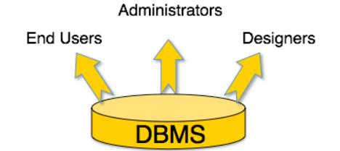
Database Users
A typical DBMS has users with different rights and permissions who use it for different purposes. Some users retrieve data and some back it up.
The users of a DBMS can be broadly categorized as follows:
Administrators − Administrators maintain the DBMS and are responsible for administrating the database. They are responsible to look after its usage and by whom it should be used. They create access profiles for users and apply limitations to maintain isolation and force security. Administrators also look after DBMS resources like system license, required tools, and other software and hardware related maintenance.

Slide 8

Database Users
Designers − Designers are the group of people who actually work on the designing part of the database. They keep a close watch on what data should be kept and in what format. They identify and design the whole set of entities, relations, constraints, and views.
 | End Users − End users are those who actually reap the benefits of having a DBMS. End users can range from simple viewers who pay attention to the logs or market rates to sophisticated users such as business analysts.

Slide 9
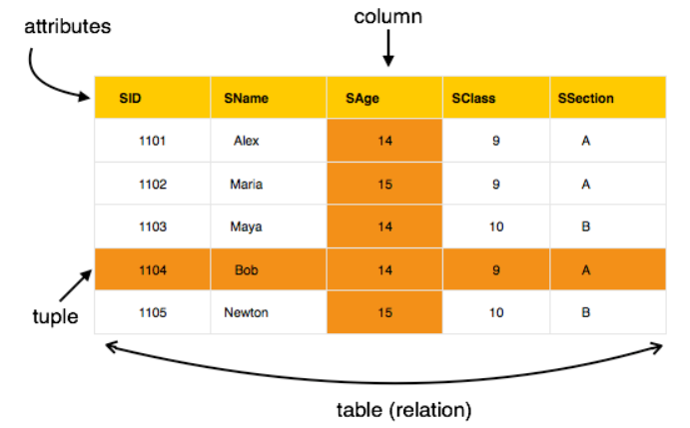
Database Model: Relational Model
The most popular data model in DBMS is the Relational Model. It is more scientific a model than others. This model is based on first-order predicate logic and defines a table as an n-array relation.
The main highlights of this model are :
Data is stored in tables called relations.
Relations can be normalized.
In normalized relations, values saved are atomic values.
Each row in a relation contains a unique value.
Each column in a relation contains values from a same domain.

Slide 10
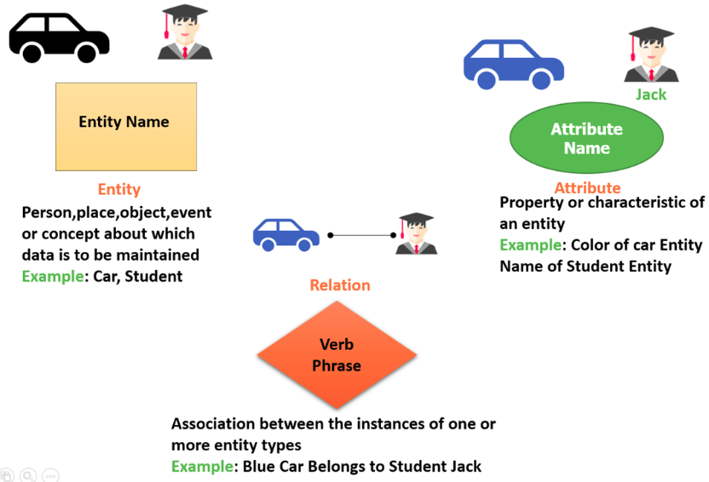
ER Model - Basic Concepts
The ER model defines the conceptual view of a database. It works around real-world entities and the associations among them. At view level, the ER model is considered a good option for designing databases.
Entity: An entity can be a real-world object, either animate or inanimate, that can be easily identifiable. For example, in a school database, students, teachers, classes, and courses offered can be considered as entities. All these entities have some attributes or properties that give them their identity.
Attributes: Entities are represented by means of their properties, called attributes. All attributes have values. For example, a student entity may have name, class, and age as attributes. There exists a domain or range of values that can be assigned to attributes.
For example, a student's name cannot be a numeric value. It has to be alphabetic. A student's age cannot be negative, etc.

Slide 11
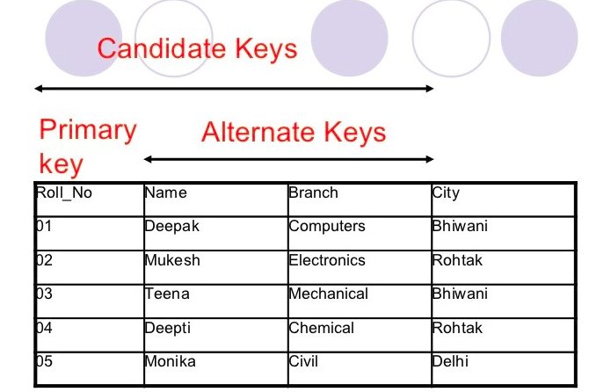
ER Model - Basic Concepts
Entity-Set and Keys
Key is an attribute or collection of attributes that uniquely identifies an entity among entity set.
For example, the roll_number of a student makes him/her identifiable among students.
Super Key − A set of attributes (one or more) that collectively identifies an entity in an entity set.
Candidate Key − A minimal super key is called a candidate key. An entity set may have more than one candidate key.
Primary Key − A primary key is one of the candidate keys chosen by the database designer to uniquely identify the entity set.

Slide 12
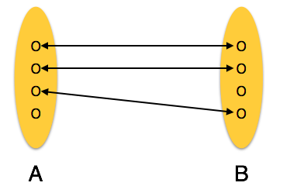
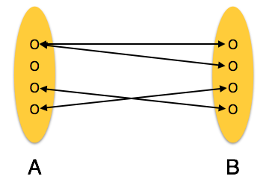
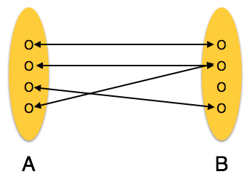
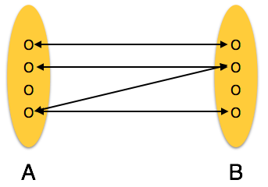
Relationship
The association among entities is called a relationship. For example, an employee works_at a department, a student enrolls in a course. Here, Works_at and Enrolls are called relationships.
Relationship Set: A set of relationships of similar type is called a relationship set. Like entities, a relationship too can have attributes. These attributes are called descriptive attributes.
Degree of Relationship: The number of participating entities in a relationship defines the degree of the relationship.
Binary = degree 2 Ternary = degree 3 n-ary = degree
Mapping Cardinalities:
Cardinality defines the number of entities in one entity set, which can be associated with the number of entities of other set via relationship set.
One-to-one | One-to-many | Many-to-one | Many-to-many

Slide 13
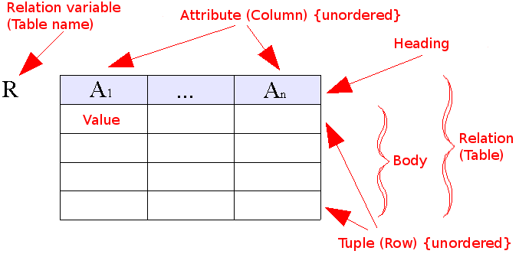
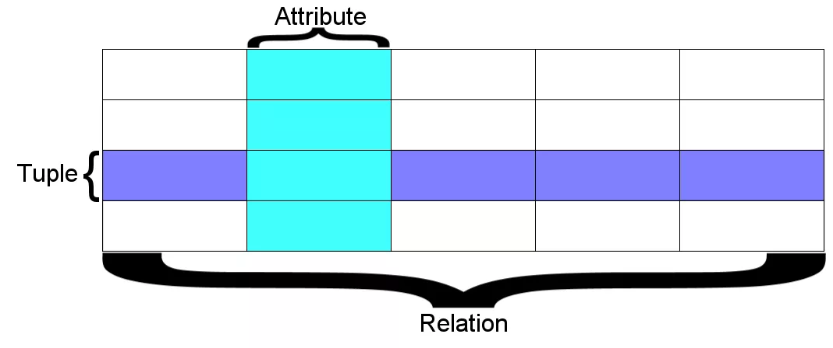
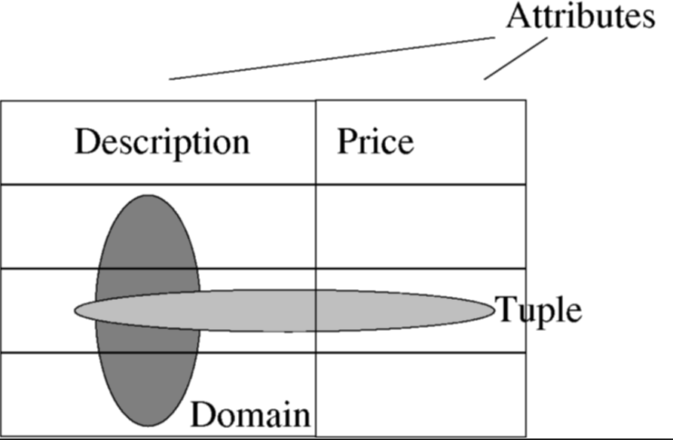
Relation Data Model - Concepts
Relational data model is the primary data model, which is used widely around the world for data storage and processing. This model is simple and it has all the properties and capabilities required to process data with storage efficiency.
Tables − In relational data model, relations are saved in the format of Tables. This format stores the relation among entities. A table has rows and columns, where rows represents records and columns represent the attributes.
 | Tuple − A single row of a table, which contains a single record for that relation is called a tuple.
Relation instance − A finite set of tuples in the relational database system represents relation instance. Relation instances do not have duplicate tuples.

Slide 14

What is SQL?
SQL is Structured Query Language, which is a computer language for storing, manipulating and retrieving data stored in a relational database.
SQL is the standard language for Relational Database System.
All the Relational Database Management Systems (RDMS) like MySQL, MS Access, Oracle, Sybase, Informix, Postgres and SQL Server use SQL as their standard database language.
Also, they are using different dialects, such as:
MS SQL Server using T-SQL,
Oracle using PL/SQL,
MS Access version of SQL is called JET SQL (native format) etc.

Slide 15

Why SQL?
SQL is widely popular because it offers the following advantages:
Allows users to access data in the relational database management systems
 | Allows users to describe the data
Allows users to define the data in a database and manipulate that data

Slide 16


Why SQL?
 | Allows to embed within other languages using SQL modules, libraries & pre-compilers.
Allows users to create and drop databases and tables.

Slide 17
Why SQL?
Allows users to create view, stored procedure, functions in a database.
 | Allows users to set permissions on tables, procedures and views

Slide 18
Time to Practice

Slide 19
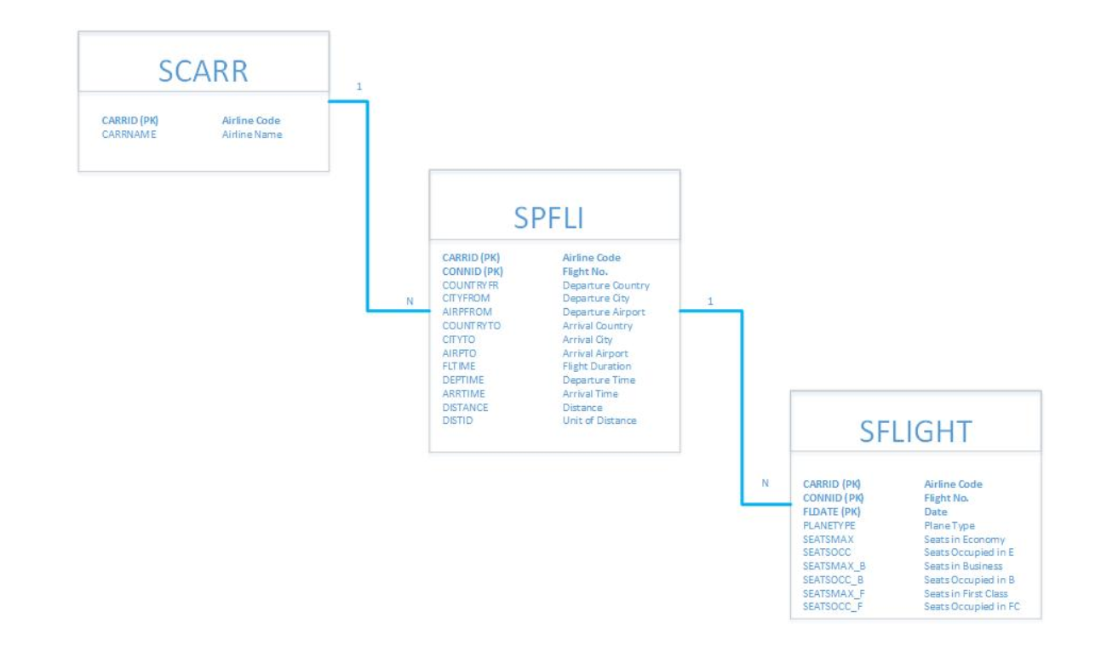
Database schema
We are going to work with the following DATABASE TABLES.
Access the DB Tables and inspect their structure and records.
Primary Key
Airline
SCARR table keeps the Airline companies and their characteristics.
Primary Key
Flight
SFLIGHT table keeps the all the flights operated by the Airlines.
Flight Schedule
SPFLI table keeps the all routes operated by the Airlines.
Primary Key

Slide 20
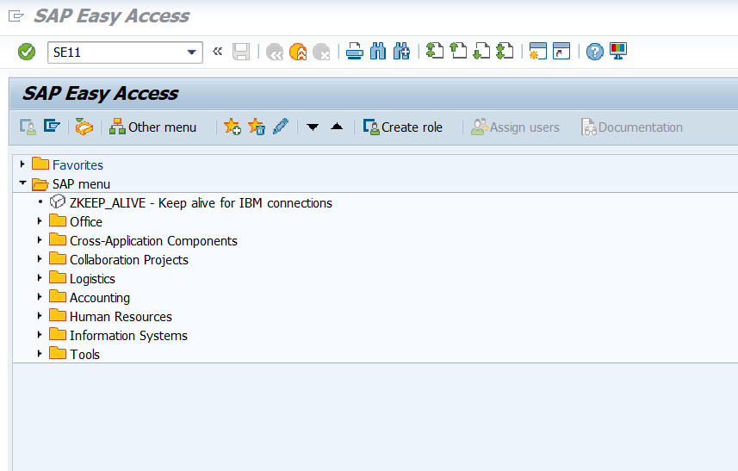
Access ABAP Dictionary – SE11

Slide 21
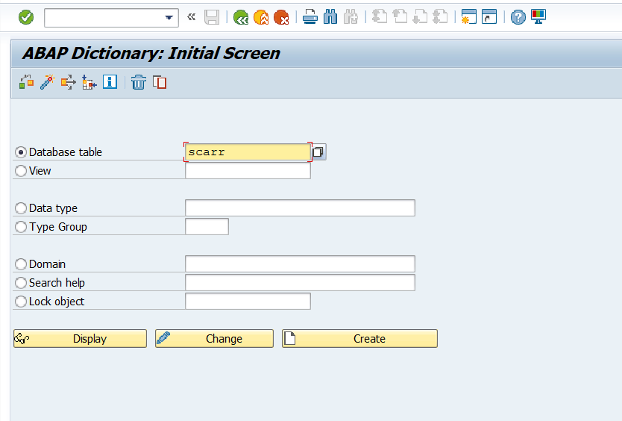
ABAP Dictionary (Global TYPES and DATA)

Slide 22
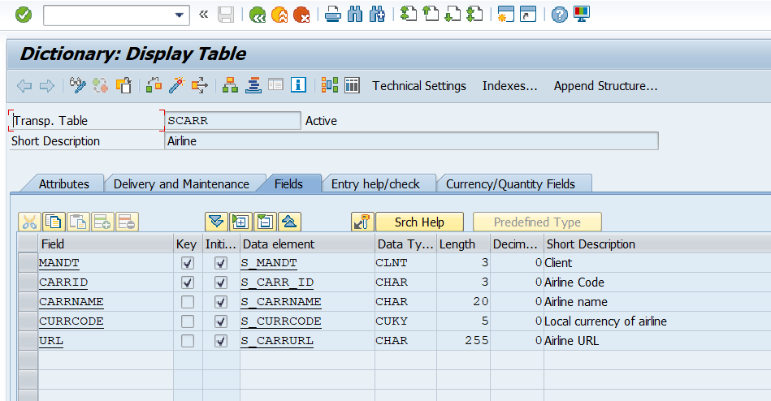
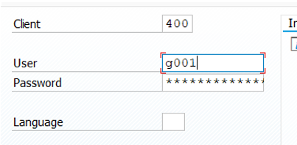
SCARR – DB table structure
OBS: MANDT field is part of the key of most of the ABAP DB table and it represents the client used during LogOn. This information is by default filled during DB table operations.

Slide 23
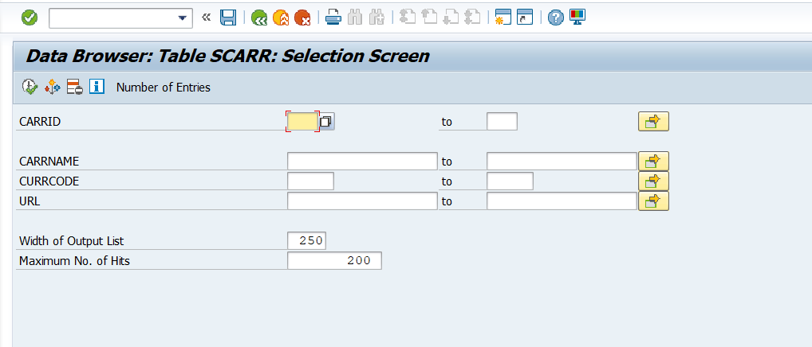
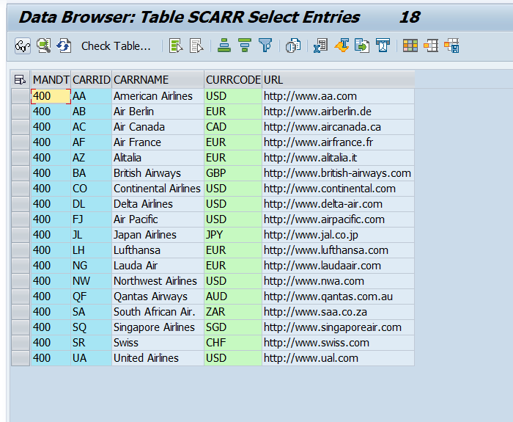
SCARR – DB table records
Display all records of table SCARR.
There are 18 Airline Companies defined in the Database.
Inspect the buttons from Application toolbar. Which button does the sort?

Slide 24
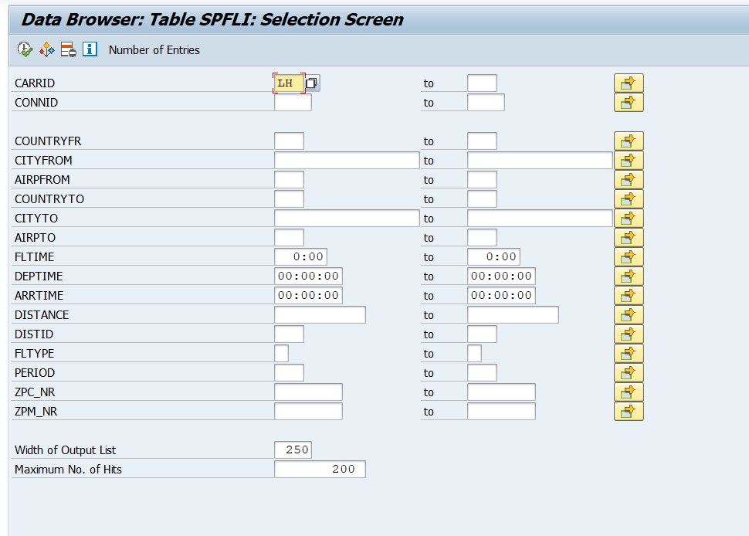
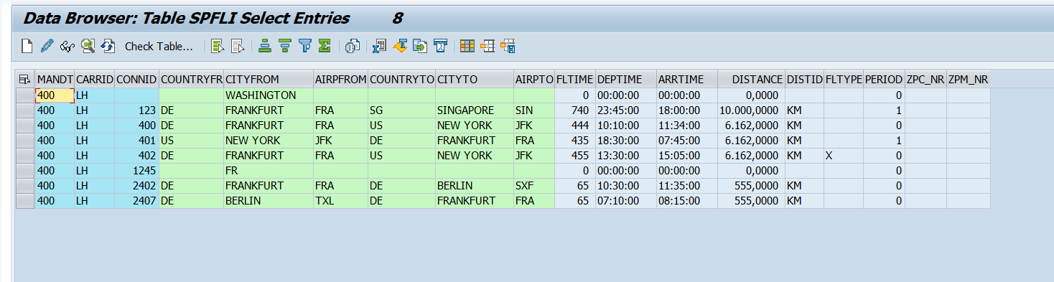
SPFLI – DB table records
Display flight schedule records for LH airline.
Access table SPFLI. Fill the CARRID (Carrier ID field) with LH and execute.
There are 8 routes operated by LH airline company, and most of them start from DE, Frankfurt.

Slide 25
Questions
Answer the following Questions:
How many Airline companies have the Local currency ‘EUR’? Display the Airlines.
How many Airline companies are operating flights From Germany (country DE)?
What is the average Flight Time of the route from New York to Frankfurt? Which company operates the flight with the highest Flight Time?
How many Flights were operated on 09.05.2018? Display the Flights.
Which Flight (company and route) had the highest Booking price (PAYMENTSUM) on 09.05.2018?
What is the Total Booking price for all routes operated on 09.05.2018?

